Slide 1
April’2025

Slide 2
Ground Rules

Slide 3
Course Objectives
By the end of this course, you will be able to know about how to:
Application for registration
Application for Amendment in Registration related particulars
Application for Cancellation of Registration
Application for Revocation of Cancellation of Registration

Slide 4
Registration Application

Slide 5
Registration Application
Different Types of Registrations and Notified Forms
Form No. | Type of Registration
REG-01 | Normal/Regular Registration Casual Taxable Person Normal Registration with composition levy Input Service Distributor
REG-07 | TDS Registration TCS Registration
REG-09 | Non-Resident Taxable Person (NRTP)
REG-10 | Non-Resident online service provider (OIDAR)
REG-13 | Unique Identification Number (UIN)
GST PCT-1 | GST Practitioner (GSTP)
ONP | Other Notified Person (To be notified)
Notes:
Facilitation Notes:
Explain who all can apply for UIN.
UN Bodies
Embassies
Any foreign agency not required to pay tax(es) in India

Slide 6
Registration Application
Registration – Threshold
Annual turnover threshold with effect from 01.04.2019:
For supply of services or goods & services
10 Lakhs for Manipur, Mizoram, Nagaland, Tripura
20 Lakhs for all other states
For supply of goods only
10 Lakhs for Manipur, Mizoram, Nagaland, Tripura
20 Lakhs for Arunachal Pradesh, Meghalaya, Sikkim, Uttarakhand, Puducherry, Telangana
40 Lakhs for all other states

Slide 7
Registration Application
Required to obtain Registration
1
Turnover Basis
2
Inter-State Supply of Goods
3
Casual Taxable Person
4
Reverse Charge Liability
8
7
TDS applicability
6
Non-Resident person
5
E-com liable to pay tax under 9(5)
Agent
9
Input Service Distributor
10
Supply through e-com collecting TCS
11
E-Com having TCS applicability
12
OIDAR - Database access or Retrieval

Slide 8
PAN based Registration details shown while filing REG-01
Registration Application
Following Color code are used to denote different status of the Existing Registration ARN:
Green Color: Green color reflects the Approved Registration Application
Red Color: Red color reflects the Rejected Registration Application
Orange Color: Orange color reflects the Pending for Processing/Pending for order Registration Application

Slide 9
Registration Application
Aadhaar Authentication
Persons excluded from Aadhaar Authentication
Aadhaar authentication is not required for :-
Government Department
Public Sector Undertaking
Local Authority
Statutory Body
Person applying for registration u/s 25(9) i.e. UIN
Person Not a citizen of India

Slide 10
Registration Application
Aadhaar Authentication
Type of Taxpayer | Constitution of Business | Nature of Person | Aadhaar Authentication Required
Regular Tax Payer (Including Casual, SEZ, ISD) and Composition Taxpayer | Proprietorship Concern | Proprietor | Yes
 |  | Primary Authorized Signatory | (if other than Proprietor)
 | Partnership Firm | Partners | Yes (1 Partner)
 |  | Primary Authorized Signatory | (if other than Partner)
 | HUF | Karta | Yes
 |  | Primary Authorized Signatory | (if other than Karta)
 | Company (Public, Private, Unlimited) | Directors | Yes (1 Director)
 |  | Primary Authorized Signatory | (if other than Director)

Slide 11
Registration Application
Aadhaar Authentication
Type of Taxpayer | Constitution of Business | Nature of Person | Aadhaar Authentication Required
Regular Tax Payer (Including Casual, SEZ, ISD) and Composition Taxpayer | Company (Foreign Limited) | Director (if not citizen / resident of India) | No
 |  | Director (if citizen / resident of India) | Yes (1)
 |  | Primary Authorized Signatory | (if other than Director)
 | Limited Liability Partnership | Designated Partners | Yes (1 Partner)
 |  | Primary Authorized Signatory | (if other than Partner)
 | Society / Club / Trust / Association of Persons | Members of Managing Committee | Yes (1 Member)
 |  | Primary Authorized Signatory | (if other than Member)
 | Other | Person in Charge | Yes (1 Member)
 |  | Primary Authorized Signatory | (if other than Member)

Slide 12
Registration Application
Aadhaar Authentication
Some important point related to Aadhar Authentication
PAS (Primary Authorized Signatory) is auto selected in the Aadhaar Authentication tab. If required, Taxpayer to select a Promoter/ Partner from the list available
PAS should be a resident / citizen of India
If there is a single Promoter/ Partner listed in the Aadhar Authentication tab and that person is PAS also, then only one person will be in the table and is auto selected and non-editable
Authentication link will be sent only to those persons that are auto selected or selected by the Taxpayer and the status for others will be shown as NA always in the Aadhar Authentication tab

Slide 13
Registration Application
Aadhaar Authentication
If taxpayer have opted “Yes” for Aadhaar authentication while registering on the GST Portal
Once “Yes” is opted for Aadhaar authentication while registering, an authentication link is shared on mobile numbers and e-mail IDs of the Primary Authorized Signatory and the Promoter/ Partner selected for authentication
Click on the link for Aadhaar authentication, a new window opens up. Enter Aadhaar number and click validate
OTP is sent to the mobile number/ email linked with the Aadhaar. Enter the OTP, once it gets successfully validated, a success message will be displayed

Slide 14
Registration Application
Aadhaar Authentication
What are the benefits taxpayer gets, if Aadhaar authentication is successful while registering on the GST Portal?
Application shall be deemed approved within 7 Working days
The registration application submitted shall not be marked for mandatory site visit

Slide 15
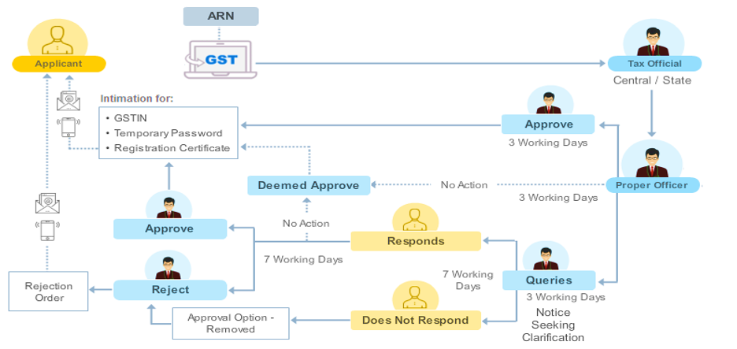
Registration Application
In case Aadhaar Authentication is Successful
Centre/State
Intimation for
*GSTIN
*temporary Password
*Registration Certificate
7 working days
No Action
7 working days
No Action
7 working days
7 working days
Rejection order
7 working days
Notice seeking Clarification
Approval option removed
CA Ikesh Nagpal

Slide 16
Registration Application
In case Aadhaar Authentication gets Failed
Taxpayer opted for Aadhaar authentication as “yes” but Aadhaar authentication is unsuccessful for e-KYC. Can he access the same authentication link for completing Aadhaar authentication?
Fresh Link need to be generated
Access it by navigating to My Saved Applications > Aadhaar Authentication Status > RESEND VERIFICATION LINK, to resend the authentication link to registered mobile number and e-mails IDs of the Promoters/ Partners or Authorized Signatories

Slide 17
Registration Application
In case Aadhaar Authentication gets Failed
In case, taxpayer have opted “Yes” for Aadhaar authentication while registering on the GST Portal and his Aadhaar details have not been successfully verified, how such registration shall be processed?
Application shall not be deemed approved within 7 Working days
The registration application submitted shall be marked for mandatory site visit

Slide 18
Registration Application
In case Aadhaar Authentication gets Failed
Centre/State
Intimation for
*GSTIN
*temporary Password
*Registration Certificate
30 calendar days
No Action
30 calendar days
No Action
30 calendar days
7 working days
7 working days
Rejection order
Notice seeking Clarification
Approval option removed
CA Ikesh Nagpal
Note: The application shall be in the submitted status for 15 days for the KYC of taxpayer before generation of ARN & there shall be mandatory site visit by the tax officer

Slide 19
Registration Application
In case No is opted for Aadhaar Authentication
In case, taxpayer has opted “No” for Aadhaar authentication while registering on the GST Portal?
Application shall be not be deemed approved within 7 Working days
The registration application submitted shall be marked for mandatory site visit
Taxpayer would need to upload the E-KYC documents for Primary Authorized signatory and 1 Promotor/Partner to proceed further

Slide 20
Registration Application
In case No is opted for Aadhaar Authentication
Documents required for E-KYC
Aadhaar Enrolment ID Slip and
And
Passport
EPIC (Voter ID Card)
Bank Passbook with photograph
Driving License
Aadhaar Enrolment ID slip is mandatorily required to be uploaded along with any other supporting document

Slide 21
Registration Application
In case No is opted for Aadhaar Authentication
Centre/State
Intimation for
*GSTIN
*temporary Password
*Registration Certificate
30 calendar days
No Action
30 calendar days
No Action
30 calendar days
7 working days
7 working days
Rejection order
Notice seeking Clarification
Approval option removed
CA Ikesh Nagpal
Note: Mandatory site visit by the tax officer

Slide 22
Registration Application
Where applicant opt for Aadhaar Authentication
When application can be selected for Bio-metric based Aadhaar authentication ?
In case Taxpayer selects “Yes” for Aadhaar authentication and submits Part-B of GST REG-01
then details are sent by System to BI module for Risk calculation
Based on the calculated risk, Taxpayers are classified into risk categories
Those falling under High-risk category are intimated via link (e-mail) for booking an appointment with a message to visit a GST Suvidha Kendra (GSK) along with the details of the GSK and jurisdiction, for Biometric-based Aadhaar authentication and document verification to get biometrically authenticated at a GSK center
The GSK (GST Suvidha Kendra) centers are to be made functional in the States where biometric authentication is applicable

Slide 23
Registration Application
Where applicant opt for Aadhaar Authentication
When application can be selected for Bio-metric based Aadhaar authentication?
The Biometric based Aadhaar authentication means:
To identify risky applicants based on certain risk parameters and such Taxpayers be directed to go through biometric authentication
To capture photograph and do biometric authentication of such applicants and do verification of original documents uploaded with application for GST registration
To be applicable in case of Normal Taxpayer for all types of constitution of business for which Aadhaar Authentication is applicable
The type of Taxpayers covered are – Regular, Casual, Composition, ISD, SEZ Unit & Developer

Slide 24
Registration Application
In case No is opted for Aadhaar Authentication – Extended Timelines
The timeline for the Officer to approve registration application or to issue notice seeking clarification get extended ?
The timeline for the Officer to approve registration application or to issue notice seeking clarification is 30 days from the date of ARN for application, in case of a person who:
does not opt for authentication of Aadhaar
opting for Aadhaar authentication but fails to complete it
opting for Aadhar authentication and application has been selected for biometric based Aadhaar authentication

Slide 25
Amendment in Registration particulars

Slide 26
Amendment in Registration particulars
Application for amendment
If there is any change in any of the particulars furnished in the application for registration then the registered person shall, within a period of 15 days of such change submit an application, electronically in FORM GST REG-14, along with the documents relating to such change at the common portal.

Slide 27
Amendment in Registration particulars
Application for amendment
Amendment in Registration
Core Fields
Non-Core Fields
To be processed by Tax officer
Processing by (approval of) Tax officer not required
Change shall be intimated within 15 days from such change
Amended upon submission of Application

Slide 28
Amendment in Registration particulars
Amendment of Core field in Registration
Amendment to Core fields require approval by the Tax Officials.
Core fields include the following changes:
Legal name / Trade name / Additional Trade name of business
(Not involving change in PAN)
Principal place of business
(Other than change in State)
Additional Place of Business
(Other than change in State)
Addition or deletion of Stakeholders
(Partners/Karta/Managing Directors and whole time Director/Members of Managing Committee of Associations / Board of Trustees/ Chief Executive officer or equivalent etc. – Not proprietor)
Notes:
Facilitation Notes:

Slide 29
Amendment in Registration particulars
Amendment of Non - Core field in Registration
Fields of the registration application except core fields are called non-core fields.
Non-core fields are available for editing, and changes in it are auto populated in registration of the taxpayer.
No approval is required from the Tax Official if any amendments are made to these fields by the taxpayers.
Notes:
Facilitation Notes:

Slide 30
Amendment in Registration particulars
Amendment of Core field in Registration
Who can file the Application for Amendment of Registration
Application for Amendment of Registration can be filed by:
Normal Taxpayers
TDS/ TCS Registrants
UN Bodies, Embassies & another notified person having UIN
Non-Resident Taxable Person
GST Practitioner
Online Information and Database Access or Retrieval Service Provider
Input Service Distributor (ISD)
Note: The GSTIN of the taxpayer should be ‘Active’.

Slide 31
Amendment in Registration particulars
Amendment of Core field in Registration
In case of amendment to Non-Core fields, approval of the Tax Officials is not required.
Non-Core fields include the following changes:
Promoters/Partner Details
Authorised Signatory
(including primary authorized signatory)
Details of Goods / services supplied by the Registered Person
Bank Accounts
State Specific Information
Notes:
Facilitation Notes:

Slide 32
Amendment in Registration particulars
Amendment of Core field in Registration
Fields cannot be amended using application of Amendment
Application for Amendment of Registration cannot be filed when there is:
Change in Constitution of Business resulting in change of PAN:- Application for Amendment of Registration form cannot be filed for change in Constitution of Business as it results in change of PAN.
Change in Place of Business from one State to other:- Application for Amendment of Registration form cannot be filled if there is change in place of business from one state to the other because GST registrations are state-specific.
Notes:
Facilitation Notes:

Slide 33
Amendment in Registration particulars
Amendment of Core field in Registration
Scenarios where amendment cannot be filed
Amendment of Registration Core Field link is disabled for taxpayer in below scenarios:-
When a taxpayer files an application for “cancellation of registration” or “Suo Moto cancellation” has been initiated by the Tax Official and the status of the GSTIN is shown as “Suspended”.
When application for “cancellation of registration” is accepted by the Tax Official or “Suo Moto cancellation” proceeding is not dropped, after hearing and the status of the GSTIN is shown as “Cancelled”.
Notes:
Facilitation Notes:

Slide 34
Amendment in Registration particulars
Amendment of Core field in Registration
Scenarios where amendment cannot be filed
Amendment of Registration Non-Core Field link is disabled for taxpayer in below scenario:
In case application for “amendment of core field(s) is applied” and an ARN is generated, and the application is still not approved by any tax authority, then you cannot apply for amendment of non-core field till the time application is approved.
Notes:
Facilitation Notes:

Slide 35
Amendment in Registration particulars
Amendment of Core field in Registration - Timelines
TIMELINES:
First time Processing of the Amendment Application | Approve or Raise SCN within 15 working days of ARN generation.
In case of Incomplete application or documents | Tax Official can raise a Notice within 15 working days of ARN generation.
If No Action by Tax Official on Application | Deemed approved if no action taken in 15 working days of ARN generation.
Notes:
Facilitation Notes:

Slide 36
Amendment in Registration particulars
Amendment of Core field in Registration – Processing of Application
TIMELINES:
Taxpayer to respond to the Notice Seeking Clarification/ Show Cause Notice(SCN) issued | Within 7 working days of receiving Notice. If no reply submitted within 7 working days, Application cannot be approved, only order for rejection can be issued.
Action (Approve/ Reject) by the Tax Officer on receipt of response of Notice | Approve or Reject within 7 working days from receipt of response to Notice. Deemed Approved if no action taken within 7 working days.
Notes:
Facilitation Notes:

Slide 37
Application for Cancellation of Registration
Notes:
Facilitation Notes:

Slide 38
Application for Cancellation of Registration
Application for Cancellation of Registration
A registered person,
other than a person to whom a registration has been granted under rule 12 (Persons required for TDS or TCS) or
a person to whom a Unique Identity Number (UIN) has been granted under rule 17,
may apply for cancellation of his registration under section 29(1) electronically by submit an application in FORM GST REG-16 on GST portal.
Notes:
Facilitation Notes:

Slide 39
Application for Cancellation of Registration
While submitting the application the details of
inputs held in stock or
inputs contained in semi-finished or
finished goods held in stock and
of capital goods held in stock
on the date from which the cancellation of registration is sought, liability thereon, the details of the payment, if any, made against such liability and may furnish, along with the application, within of 30 days of the occurrence of the event.
Notes:
Facilitation Notes:

Slide 40
Application for Cancellation of Registration
Occurrence of the event ?
The business has been discontinued, transferred fully for any reason including death of the proprietor, amalgamated with other legal entity, demerged or otherwise disposed of; or
There is any change in the constitution of the business; or
The taxable person is no longer liable to be registered under section 22 or section 24 or intends to optout of the registration voluntarily made under sub-section (3) of section 25.
Note - During pendency of the proceedings relating to cancellation of registration filed by the registered person, the registration may be suspended for such period and in such manner as may be prescribed.
Notes:
Facilitation Notes:

Slide 41
Application for Revocation of Cancellation of Registration
Notes:
Facilitation Notes:

Slide 42
Application For Revocation of Cancellation
Any registered person, whose registration is cancelled by the proper officer on his own motion, may apply to such officer for revocation of cancellation of the registration within 90 days from the date of service of the cancellation order.
Period of 90 days may, on sufficient cause being shown, and for reasons to be recorded in writing, be extended :-
for a further period not exceeding 180 days
by the Commissioner or an officer authorized by him, not below the rank of Additional Commissioner or Joint Commissioner
(In other words, Total time available for filing the application is 270 days)
Adhaar Authentication is pre-requisite for filing revocation application (Rule 10B).
Notes:
Facilitation Notes:

Slide 43
Application For Revocation of Cancellation
Where cancellation of registration is due to Non-Filing of returns
Portal will not allow to file revocation application unless registered person file all returns along with payment of tax, interest, penalty or late fee, etc.
Such person shall file all returns for the period
from the date of the order of cancellation of registration
till the date of the order of revocation of cancellation of registration
within a period of 30 days from the date of order of revocation of cancellation of registration:
Where the registration has been cancelled with retrospective effect, such person shall furnish all returns relating to period
from the effective date of cancellation of registration
till the date of order of revocation of cancellation of registration
within a period of 30 days from the date of order of revocation of cancellation of registration
Notes:
Facilitation Notes:

Slide 44
Application For Revocation of Cancellation
Where the proper officer is satisfied, he shall revoke the cancellation of registration by an order within a period of 30 days from the date of the receipt of the application.
Proper officer may also, reject the application for revocation of cancellation of registration.
The proper officer shall issue show cause notice before passing the rejection order, as to why the application submitted for revocation should not be rejected and the applicant shall furnish the reply within a period of 7 working days from the date of the service of the notice.
Upon receipt of the information or clarification, the proper officer shall proceed to dispose of the application within 30 days from the date of the receipt of such information or clarification from the applicant.
Notes:
Facilitation Notes:

Slide 45
Application For Revocation of Cancellation
Processing of Application for Revocation of Cancelled Registration
First time processing of Application for Revocation of Cancelled Registration | Tax Official to Approve or Raise SCN for the Application for Revocation of Cancelled Registration within 30 days of ARN generation.
No Action by Tax Official on application | An alert will be sent to tax official in case he does not process the application within 30 days from the date of receipt of application
In case of incomplete application or documents | Tax Official can generate SCN within 30 working days of ARN generation.
Time Limit for Taxpayer to respond to the Show Cause Notice (SCN) issued | Within 7 working days of receiving the Show Cause Notice. If no reply has been submitted by the Taxpayer within <7> days of issue of SCN, Application cannot be approved, only order for rejection can be issued.
Action (Approve/ Reject) to be taken by the Tax Officer on receipt of response of Show Cause Notice (SCN) | Tax Official to Approve or Reject the Application for Revocation of Cancelled Registration within 30 days for processing from date of receipt of response to Show Cause Notice.
Notes:
Facilitation Notes:

Slide 46
Application For Revocation of Cancellation
Rule 10B - Aadhaar authentication for registered person
Existing registered taxpayer, after login at GST portal will be shown a pop-up regarding Aadhaar Authentication / e-KYC.
If Aadhaar number has not been assigned to the person then option for uploading e-KYC Documents is also displayed using which taxpayer can upload the e-KYC documents, such person shall furnish the 2 identification documents :-
her/his Aadhaar Enrolment ID slip;
Anyone document from the below mentioned list :-
Bank passbook with photograph; or
Voter identity card issued by the Election Commission of India; or
Passport; or
Driving license issued by the Licensing Authority
Notes:
Facilitation Notes:

Slide 47
Application For Revocation of Cancellation
Rule 10B - Aadhaar authentication for registered person
However, such person shall undergo the authentication of Aadhaar number within a period of 30 days of the allotment of the Aadhaar number.
In case of e-KYC authentication, the process would be subject to approval of uploaded e-KYC documents by Tax Official.
Aadhaar Authentication is not required for Government Departments, Public Sector Undertaking, Local Authority or Statutory Body.
Case where Aadhaar authentication need to do :-
For filing of application for revocation of cancellation of registration in FORM GST REG-21 under Rule 23.
For filing of refund application in FORM RFD-01 under rule 89.
For refund under rule 96 of the integrated tax paid on goods exported out of India.
Notes:
Facilitation Notes:

Slide 48
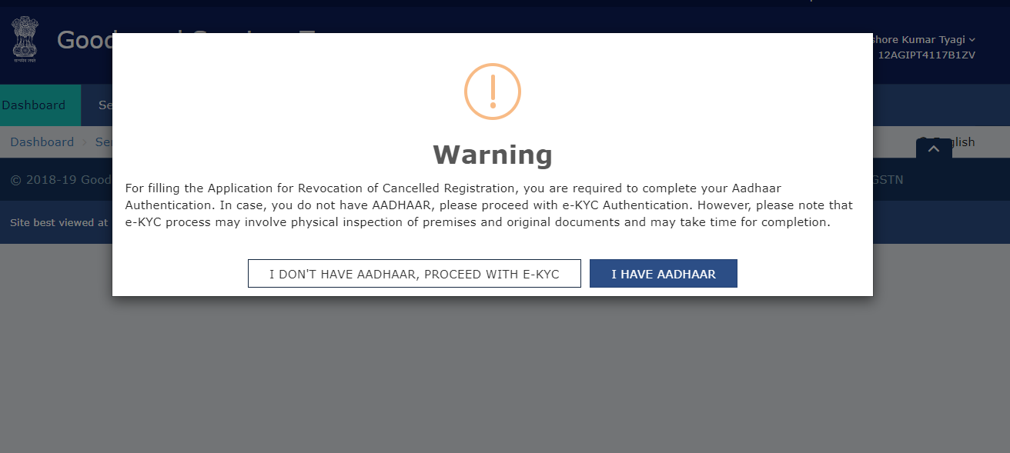
Application For Revocation of Cancellation
Notes:
Facilitation Notes:

Slide 49
End of Module – New Registration Application
THANK YOU!

